Slide 1
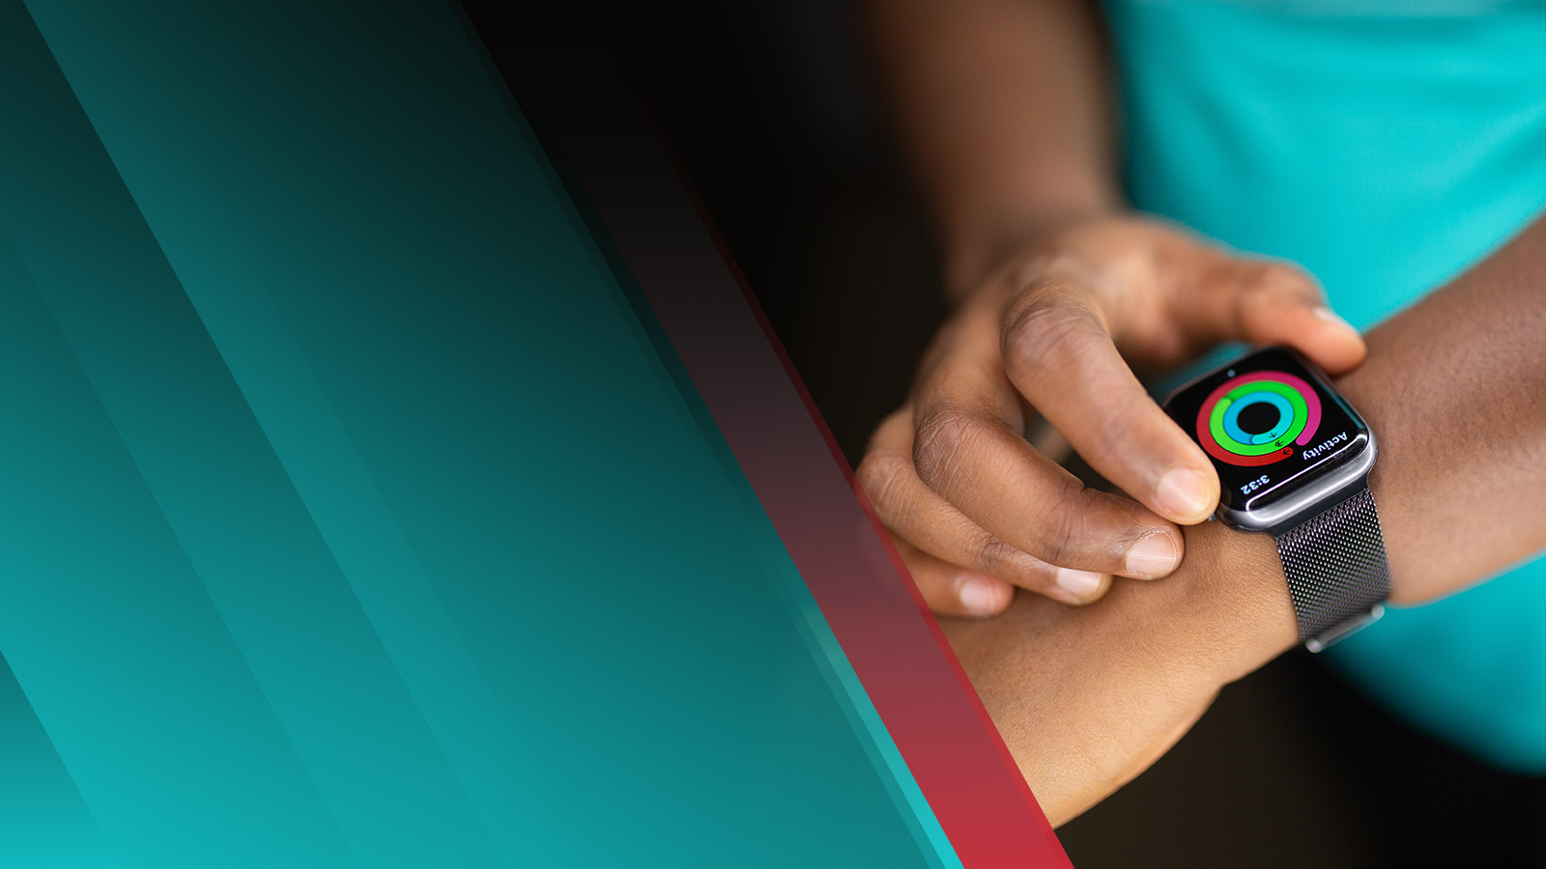
Smart Watches
DT Lab Assignment 2
VEDANT VICHARE
Roll NO : 35
prn:103222186
This presentation uses a free template provided by FPPT.com
www.free-power-point-templates.com

Slide 2
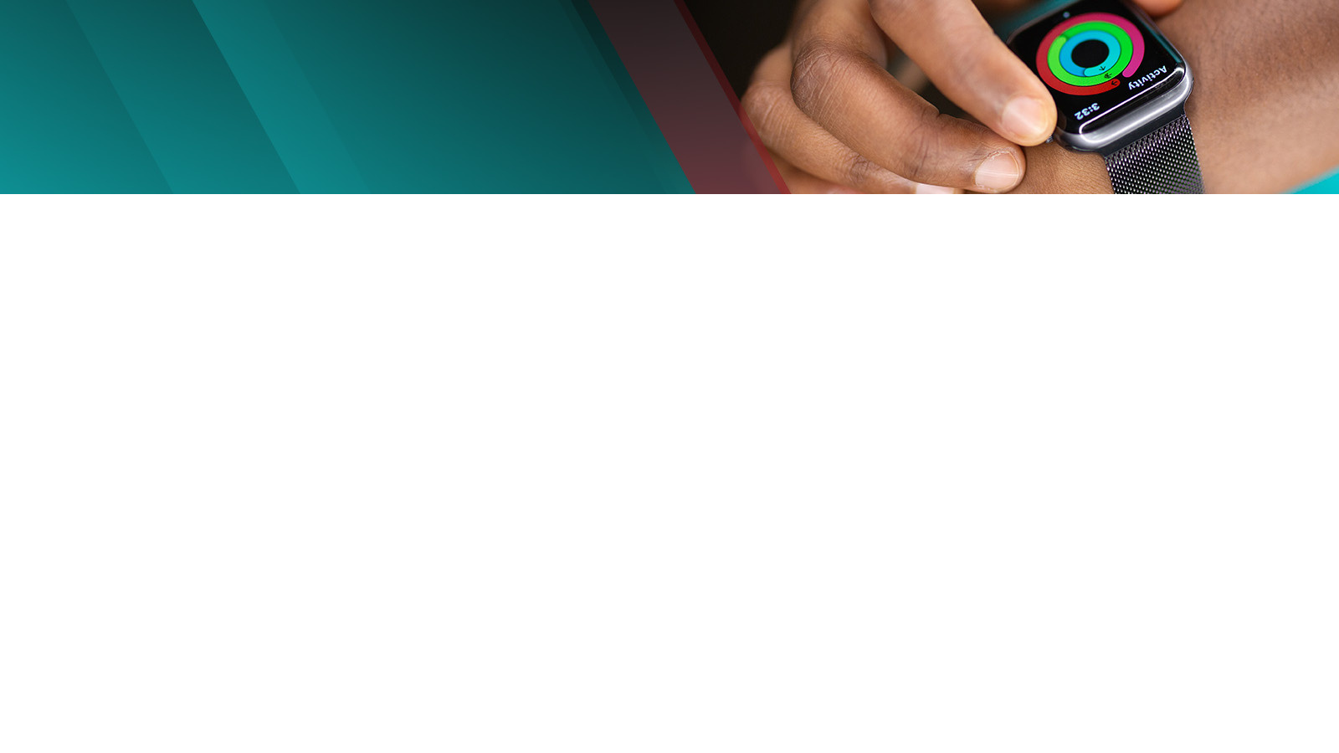
General introduction of product:
A smart watch is a wearable computer in the form of a watch; modern smart watches provide a local touch screen interface for daily use.
A smart watch is a portable device that's designed to be worn on a wrist. Like smart phones, they use touch screens, offer apps, and often record your heart rate and other vital signs.
The first digital watch, which debuted in 1972, was the Pulsar manufactured by Hamilton Watch Company. "Pulsar" became a brand name which would later be acquired by Seiko in 1978.
With the introduction of personal computers in the 1980s, Seiko began to develop computers in the form of watches.
Apple, Samsung, Sony, and other major players offer smart watches on the consumer market.
This presentation uses a free template provided by FPPT.com
www.free-power-point-templates.com

Slide 3
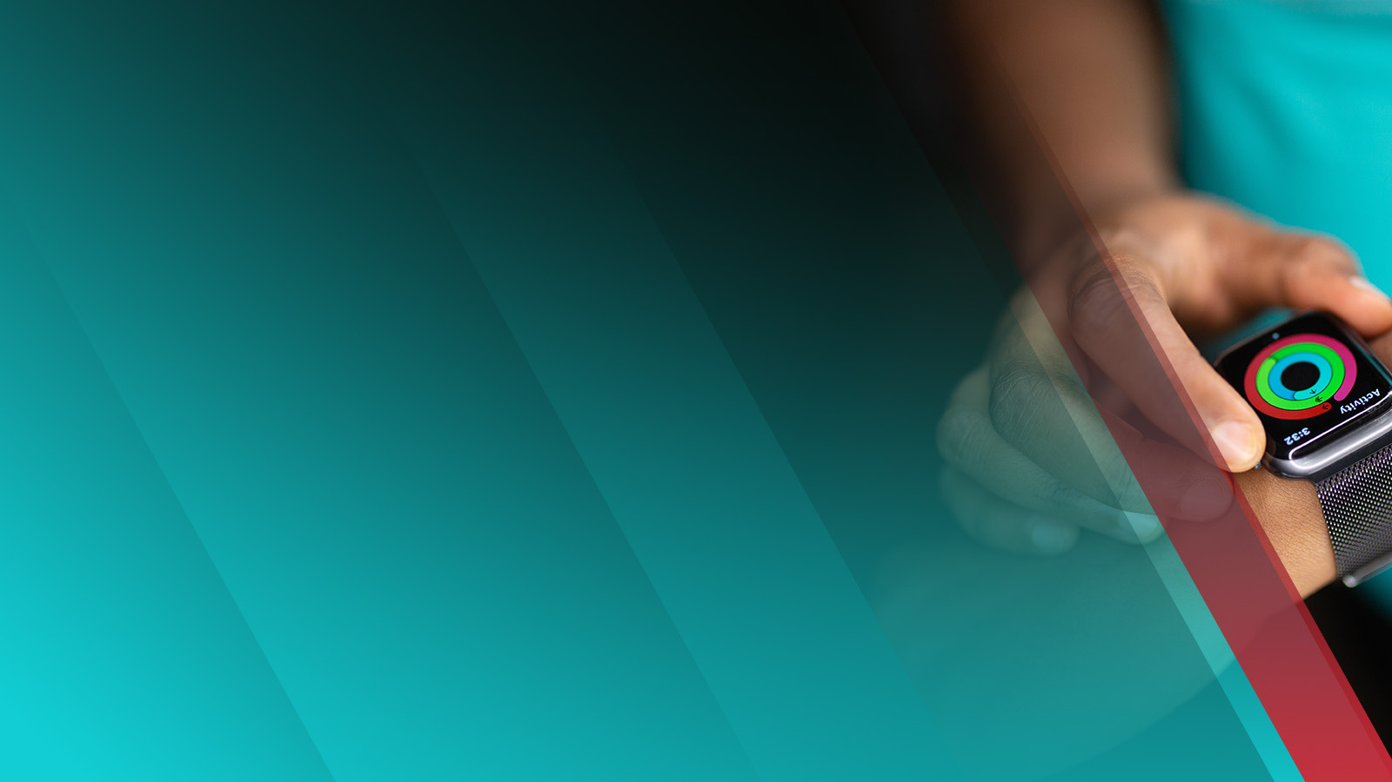
Features and benefits of smart watch:
Smart phones display notifications to alert you of important events or activities. The types of notifications differ; devices connected to a smart phone may simply mirror the phone's notifications on your wrist, but other smart watches display notifications that only a wearable could provide. It consists of microprocessor, wireless transceiver IC, GPS IC, display, sensors, buttons and wrist band.
App ecosystems vary, and they're tied to either Apple's or Google's environments. Smart watches with a dedicated purpose, such as sport activities like running, hiking or diving, generally support the apps they need to accomplish that purpose without the opportunity to add other kinds of apps.
Fitness tracking: If you’re a hard-core athlete, a dedicated fitness band is likely a better choice than a smart watch. Still, many smart watches include a heart rate monitor and a pedometer to help track your workouts.
Media management: Most smart watches paired with smart phones can manage media playback for you. For example, when you're listening to music on an iPhone using Apple's Air Pods, you can use your Apple Watch to change volume and tracks.
GPS: Most smart watches include a GPS for tracking your location or receiving location-specific alerts.
Sleep Analysis: Analyzing sleep patterns and providing suggestions for better sleep.
This presentation uses a free template provided by FPPT.com
www.free-power-point-templates.com

Slide 4
Application of smart watch
The watch becomes a wireless Bluetooth adaptor capable of extending the capabilities of the wearer's smart phone to the watch.
Fitness tracker count calories burn ,heartbeat , bloodoxygen level etc.
messaging and calling features, similar to those on a smart phone;
emergency calls for assistance if the watch detects the wearer has fallen;
social media and other notifications from synchronized smart phone applications;
games, music, photos and other entertainment options;
location features, such as maps, a compass and
Gps tracking.
This presentation uses a free template provided by FPPT.com
www.free-power-point-templates.com

Slide 5
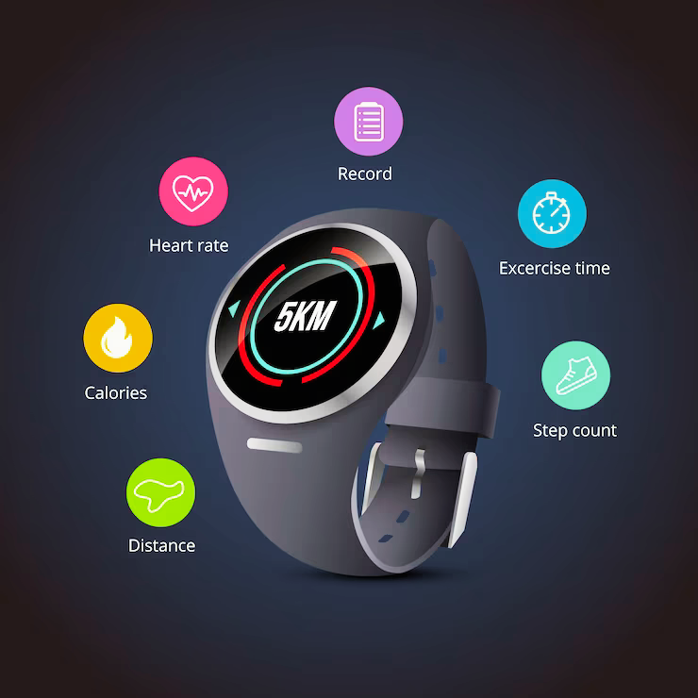
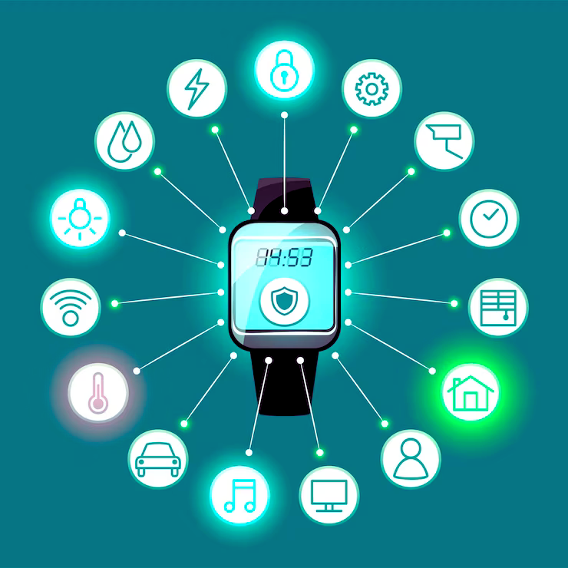

Slide 6
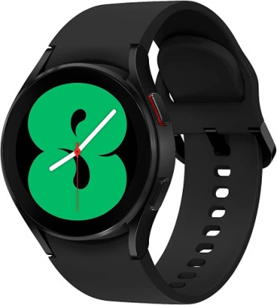
Specifications(Product: Samsung watch 4)
Only compatible with Android Smart phones (Runs on Wear OS Powered by Samsung)
Bluetooth connectivity
Bioelectrical Impedance Analysis Sensor for Body Composition Analysis, Optical Heart Rate Sensor and health monitoring features such as Advanced Sleep Analysis.
Enhanced Fitness tracking lets you track 90+ workouts; Enriched App availability and connectivity with Wear OS, Powered by Samsung. Typical Usage Time (Hours): up to 40 Hours.
With Call Function
Touchscreen
Fitness & Outdoor Battery Runtime: Upto 40 hrs.
This presentation uses a free template provided by FPPT.com
www.free-power-point-templates.com

Slide 7
PRICING
Entry-Level: 2,000rs - 10,000rs: Basic fitness tracking features, limited smart capabilities. E.g. firebolt , noise , boat , amazfit etc
Mid-Range: 10,000rs - 25,000rs
Better fitness tracking, more advanced features, and improved build quality. E.g. Samsung , Fossile
Premium: 25,000rs - 50,000rs
High-end fitness tracking, advanced health monitoring, premium materials, and more smart features. E.g. Apple
Luxury: 50,000rs and above: Top-of-the-line smartwatches from renowned brands, often with luxury materials and exclusive features. E.g. Garmin
This presentation uses a free template provided by FPPT.com
www.free-power-point-templates.com

Slide 8
Availability:
Online retailers: websites like amazon,flipcart and other official brand websites.
Electronic stores: Physical electronic stores often carry selection of smart watches to choose from.
Mobile carrier stores offer smart watches that are compatible with their services.
Fitness and sport stores: these stores carry fitness oriented smart watches.
Authorized Resellers: Check if there are authorized resellers of the brand you're interested in within your locality. These stores are likely to have the latest models available.
International Shipping: If a particular model is not available locally, you might explore the option of purchasing from international retailers that offer shipping to your country.
This presentation uses a free template provided by FPPT.com
www.free-power-point-templates.com

Slide 9
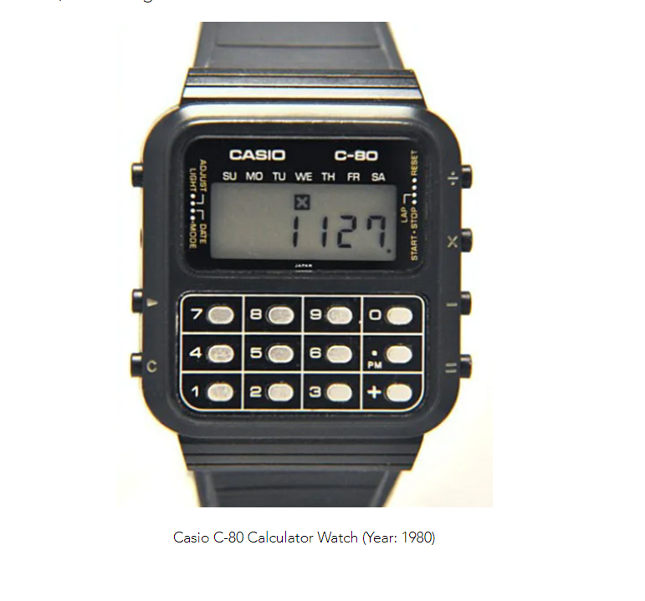
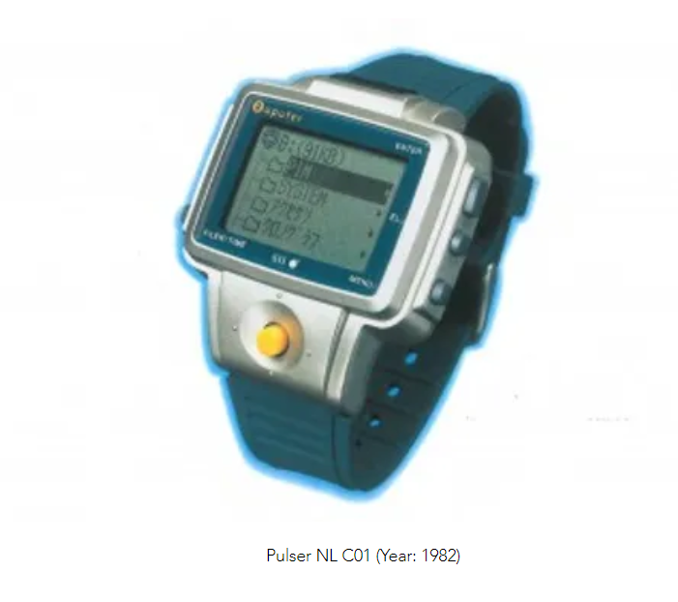
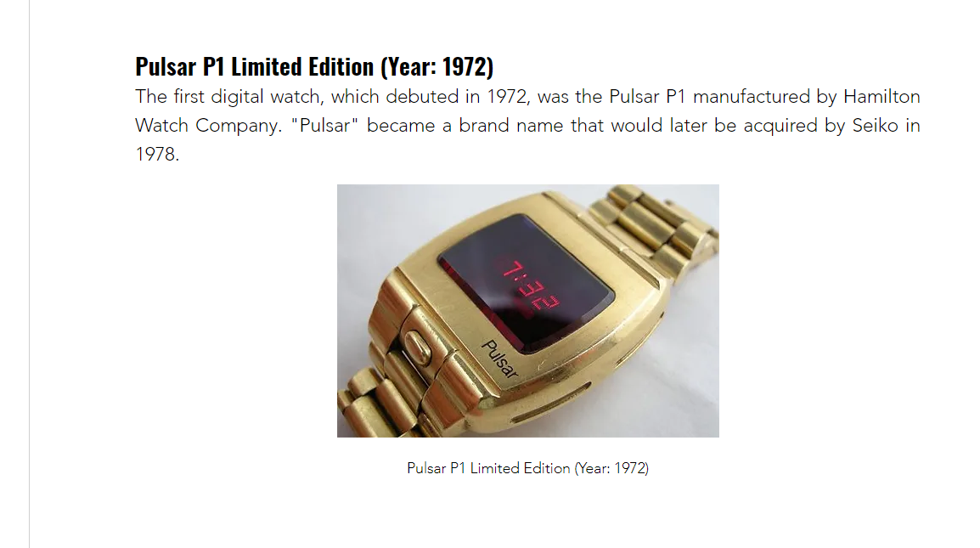
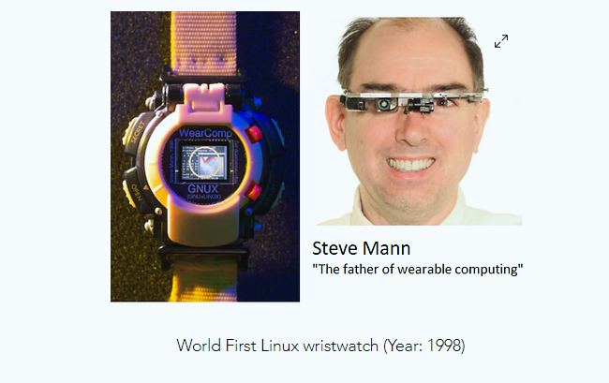
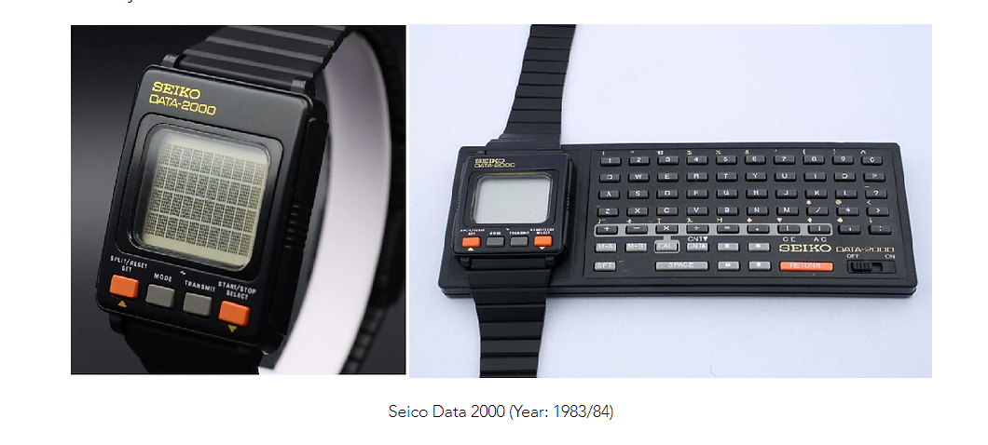

Slide 10
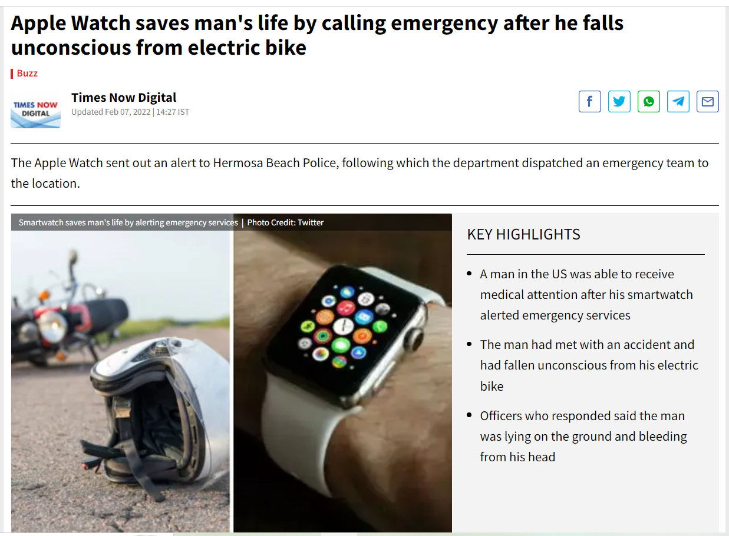

Slide 11
Thank you
This presentation uses a free template provided by FPPT.com
www.free-power-point-templates.com

